Slide 1
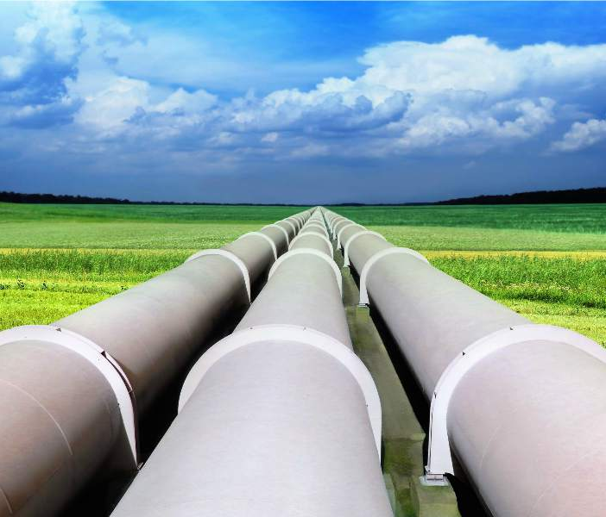
Leak Prediction in
Pipeline
Pankaj Sharma

Slide 2
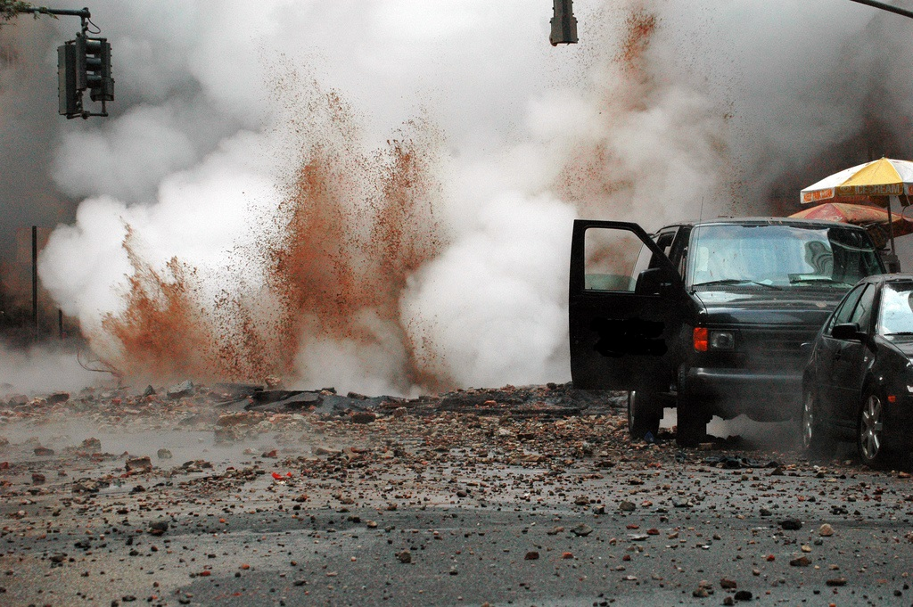
INTRODUCTION
Corrosion (FAC) is a pervasive problem in industrial pipelines (oil, gas, steam, water etc.)
It has caused accidents with serious injury or death in several steam pipelines, including nuclear power system as well as fossil-fired power plants.

Slide 3
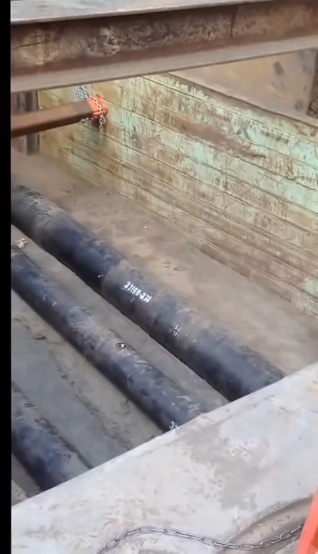
Video slide
WATER HAMMER INCIDENT

Slide 4
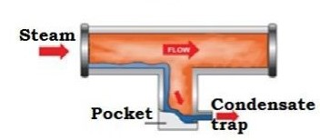
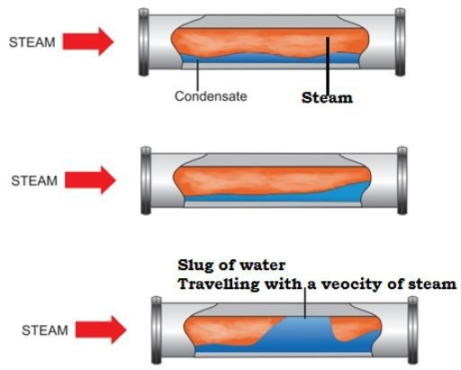
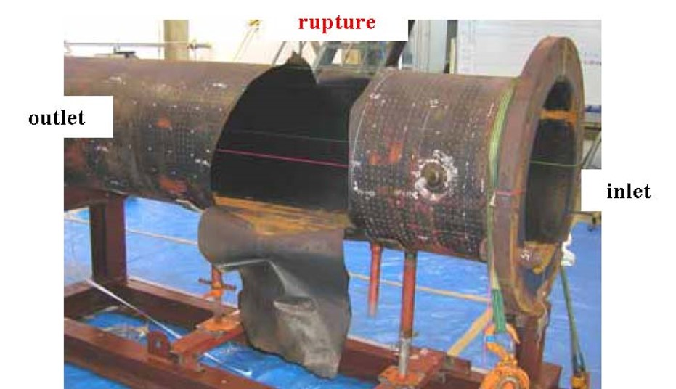
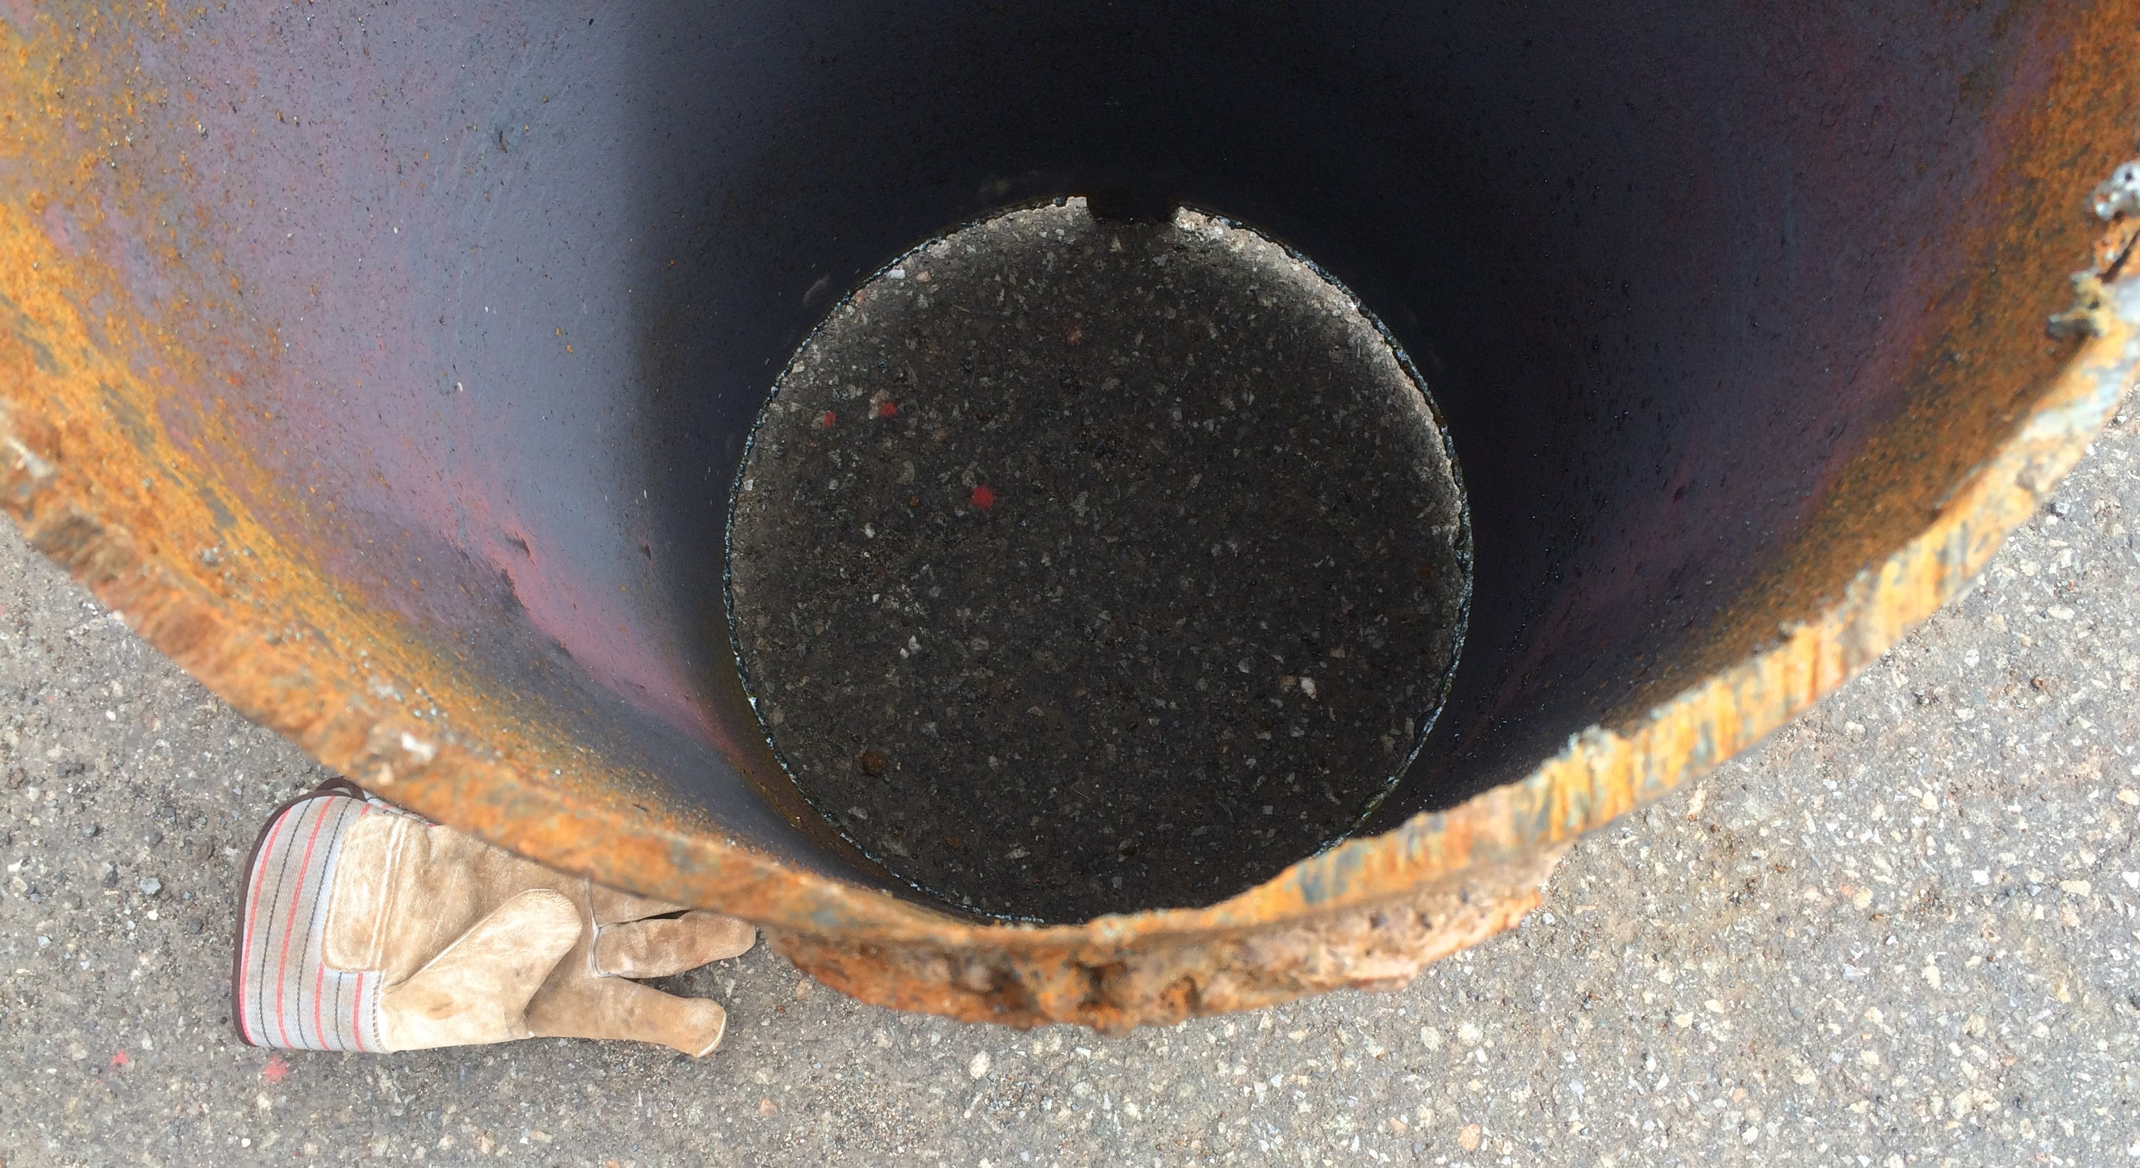
Mechanism of steam Pipe RUPTURE
1
3
6
4
5
2

Slide 5
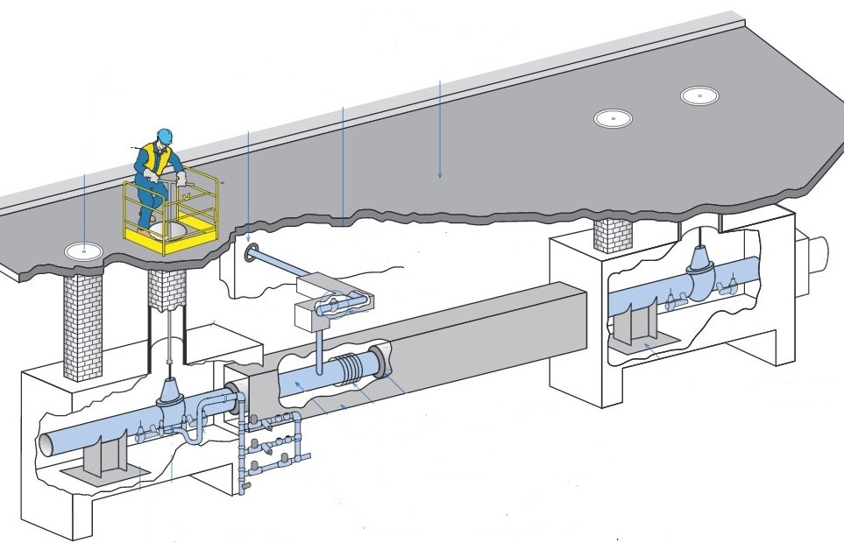
Nuclear Plant PIPELINE Dataset
Dataset_1= 1582 observations × 24 features (messy data of pipe sections with known and unknown leaks)
Dataset_2= 94 observations x 26 features (data of pipe sections with known leaks)
Features:
TID
Structure ID
High Point ID
Design Type
Location
Pipe Size
Depth of Pipe from High Point
Btu/hr-ft
Length of Pipe from High Point
Heat Loss High Point
Condensate Generation lb/hr
Main Size
Pipe Area Sq.ft
Fill Time (min)
Route
Stop
Point Type
Removal Date

Slide 6
Data cleaning and FEATURE ENGINEERING
Imputed missing values using Thermodynamic calculations.
Changed categorical features into numerical scale values using One Hot Encoding.
Separated known leak (dataset_2) observations from dataset_1
Dropped columns (TID, Location, Structure ID, Stop, Route etc.)

Slide 7
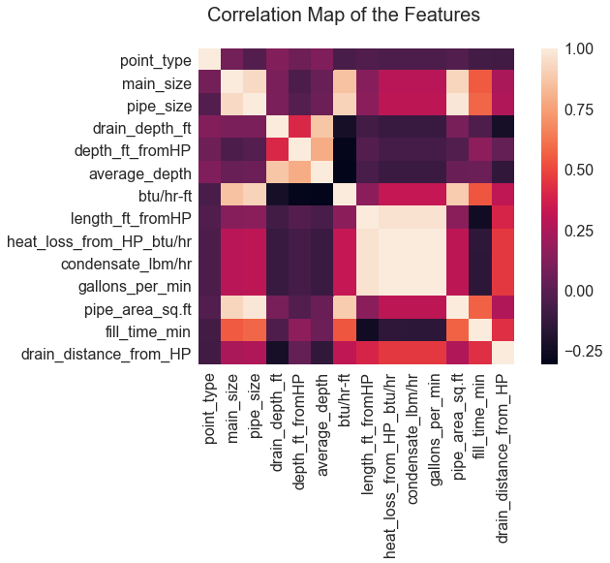
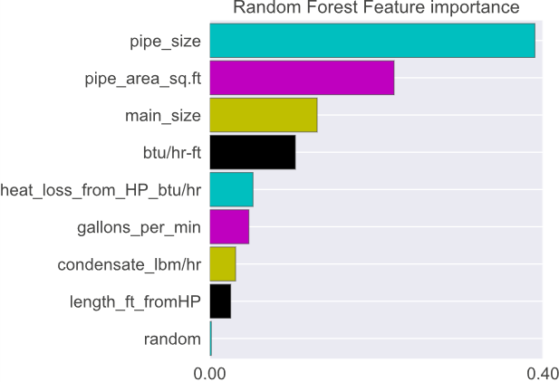
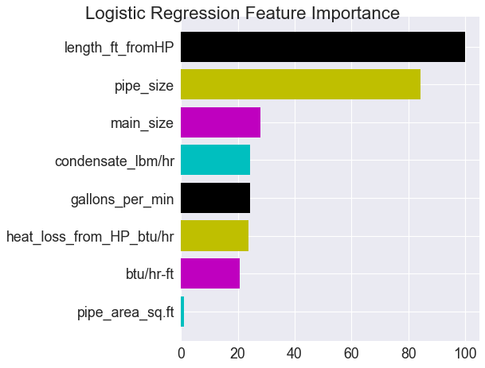
CORRELATION AND FEATURE IMPORTANCE
Correlation Map
Random Forest
Logistic Regression

Slide 8
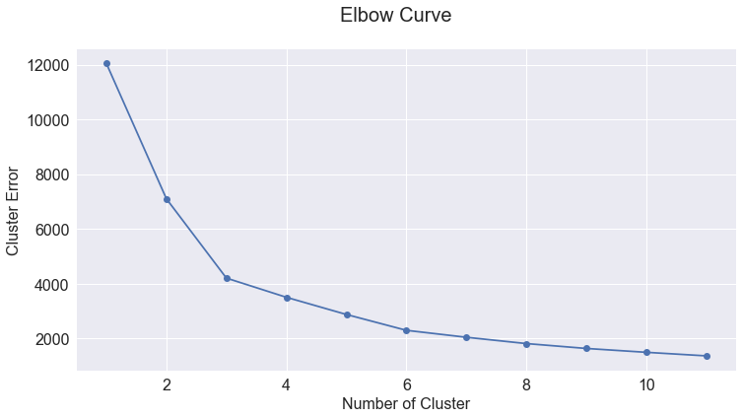
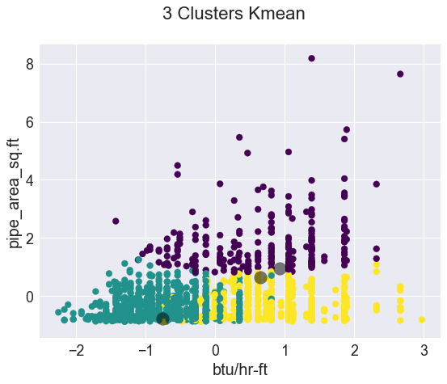
Number of clusters
Elbow Method
Clustering

Slide 9
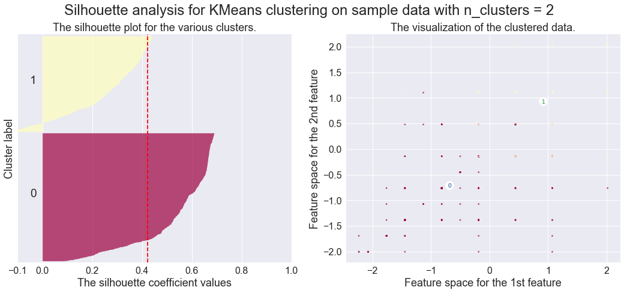
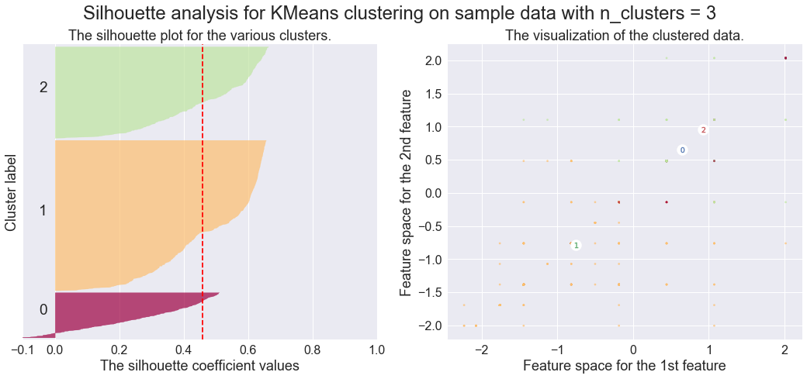
Evaluated quality of clusters using silhouette analysis
No. of clusters = 2
Average silhouette score is : 0.42
No. of clusters = 3
Average silhouette score is : 0.46

Slide 10
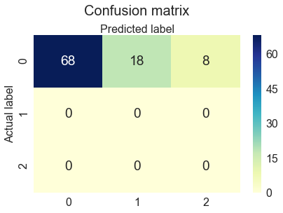
LOGISTIC REGRESSION CONFUSION MATRIX
Accuracy: 0.723404255319149

Slide 11
Conclusions and lessons learned
More features are required for robust prediction such as:
Age of pipe
Temperature and Pressure drop
Steam Quality
The following features appear to have the most influence on a leak prediction in steam pipelines:
Pipe size
Main Size
Pipe length from high point
Condensate generate lb./hr

Slide 12

Thank YOU
Pankaj Sharma

